Slide 1
Smart Parking System
By using iot

Slide 2
IoT Based Car Parking System Using Arduino
In this project we are going to construct a smart vehicle parking system that connects to internet to help a car driver or any vehicle owner to check if there is a vacant parking spot exist in a parking lot even before the driver reach the intended parking lot destination.

Slide 3
What is an IoT Based Parking System?
An IoT based parking system is a vehicle parking management system to ease the search for a vacant parking spot in a parking lot through a smartphone. The system utilizes various sensors and microcontrollers with internet capability for detecting parked vehicles and to update the data in real-time on internet.

Slide 4
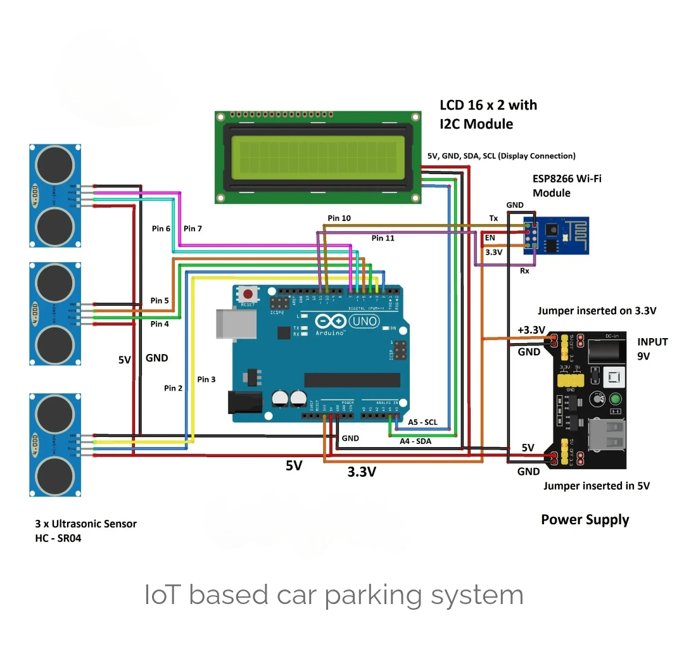
SMART PARKING Monitoring system
The illustrated schematic consists of commonly available and easy to find modules. The brain of the project is an Arduino board and you can use any Arduino board with ATmega328p microcontroller.

Slide 5
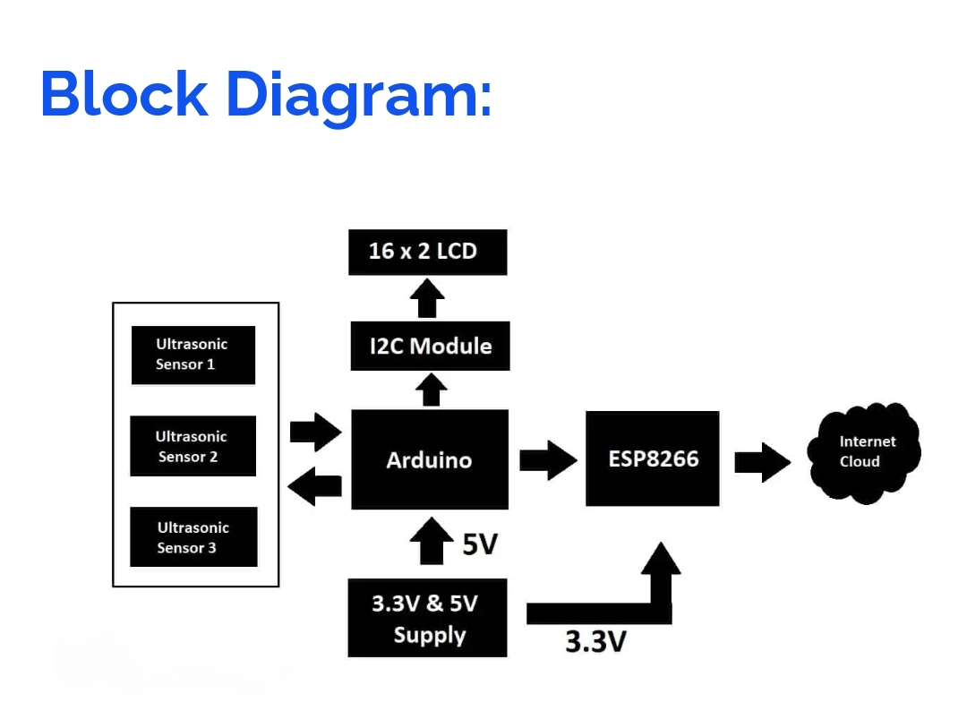
Block diagram

Slide 6
Program
#include <LiquidCrystal_I2C.h>
#include <SoftwareSerial.h>
SoftwareSerial mySerial(10, 11);
LiquidCrystal_I2C lcd(0x27, 16, 2);
// set the LCD address to 0x27 for a 16 chars and 2 line display
const int trig_1 = 2;
const int echo_1 = 3;
const int trig_2 = 4;
const int echo_2 =5; const int trig_3 = 6;
const int echo_3 = 7;
float distanceCM_1 = 0, resultCM_1 = 0;

Slide 7
float distanceCM_2 = 0, resultCM_2 = 0;
float distanceCM_3 = 0, resultCM_3 = 0;
long Time_1, Time_2, Time_3;
float car_1, car_2, car_3;
float Dist_1 = 8.0, Dist_2 = 8.0, Dist_3 = 8.0;
int total = 0, timer_cnt = 0;
void setup()
{
mySerial.begin(115200);
pinMode(trig_1, OUTPUT);
pinMode(trig_2, OUTPUT);
pinMode(trig_3, OUTPUT);
pinMode(echo_1, INPUT);
pinMode(echo_2, INPUT);
pinMode(echo_3, INPUT);
digitalWrite(trig_1, LOW);
digitalWrite(trig_2, LOW);
digitalWrite(trig_3, LOW);
lcd.init(); lcd.backlight();
lcd.setCursor(0, 0);
lcd.print(" IoT CAR PARK");
lcd.setCursor(0, 1);
lcd.print(" MONITOR SYSTEM");
delay(2000);
lcd.clear();
}

Slide 8
void loop()
{
total = 0;
car_1 = sensor_1();
car_2 = sensor_2();
car_3 = sensor_3();
lcd.setCursor(0, 0);
lcd.print("CAR1:");
if (car_1 <= Dist_1)
{
lcd.print("OK ");
}
else
{
total += 1;
}
if (car_1 > Dist_1) lcd.print("NO ");
lcd.print("CAR2:");
if (car_2 <= Dist_2)
{
lcd.print("OK ");
}
else
{
total += 1;
}

Slide 9
if (car_2 > Dist_2) lcd.print("NO ");
lcd.setCursor(0, 1);
lcd.print("CAR3:");
if (car_3 <= Dist_3)
{
lcd.print("OK ");
}
else
{
total += 1;
}
if (car_3 > Dist_3) lcd.print("NO ");
lcd.print("FREE:");
lcd.print(total);
if (timer_cnt >= 50)
{
mySerial.print('*');
mySerial.print(total);
mySerial .println('#');
timer_cnt = 0;
}
timer_cnt += 1;
delay(200);
}
float sensor_1(void)
{
digitalWrite(trig_1, HIGH);

Slide 10
delayMicroseconds(10);
digitalWrite(trig_1, LOW);
Time_1 = pulseIn(echo_1, HIGH);
distanceCM_1 = Time_1 * 0.034;
return resultCM_1 = distanceCM_1 / 2;
}
float sensor_2(void)
{
digitalWrite(trig_2, HIGH);
delayMicroseconds(10);
digitalWrite(trig_2, LOW);
Time_2 = pulseIn(echo_2, HIGH);
distanceCM_2 = Time_2 * 0.034;
return resultCM_2 = distanceCM_2 / 2;
}
float sensor_3(void)
{
digitalWrite(trig_3, HIGH);
delayMicroseconds(10);
digitalWrite(trig_3, LOW);
Time_3 = pulseIn(echo_3, HIGH);
distanceCM_3 = Time_3 * 0.034;
return resultCM_3 = distanceCM_3 / 2;
}

Slide 11
Thank you
_ _ _ _ _END_ _ _ _ _

